Slide 1
CHM 5175: Part 2.2
Introduction to Molecular Photophysics
Ken Hanson
MWF 9:00 – 9:50 am
Office Hours MWF 10:00-11:00

Slide 2
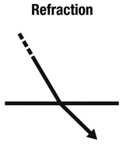
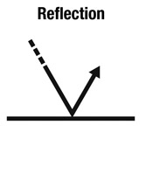
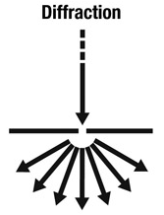
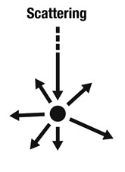
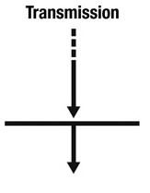
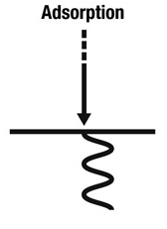
Interaction of Light with Matter
Rainbows
Glasses
Mirage
Refractometer
Moon Light
Butterfly Wings
Sea Shells
Soap Bubbles
Two-slit exp
Holograms
Shadow Blur
Sand in Water
Sunsets
UV-Vis
Fluorometry
TA
Solar Cells
Notes:
Reflection:
Pigmented Color vs structural color
structural color changes with angle
Refraction:
light travels at different speeds
Diffraction:
bending and spreading out of waves at small openings

Slide 3
Interaction of Light with Matter
Narrowing Our Focus
Absorption/Transmission
Visible spectrum
Electronic Transitions- electrons excited from one energy level to another.
Atomic
Molecular
Materials
Visible Light (hν)
Sample
Notes:
Electronic excitation

Slide 4
Hydrogen Absorption
hν
Energy
hν
Ground State
Excited State
Notes:
does an orbital exist if there is no electron in it
Follows Aufbau Principle

Slide 5
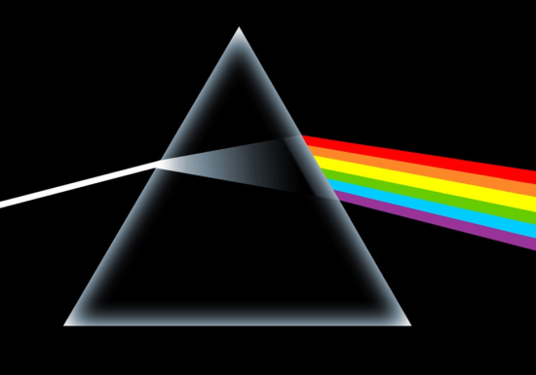
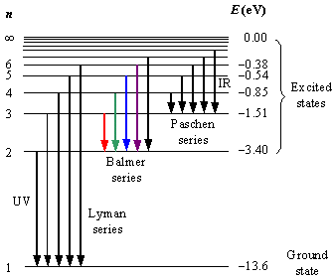
Hydrogen Absorption
H
H
H
H
H
H
H
“white” light source
Hydrogen Sample
Prism
Line Spectrum
Rydberg Formula
Notes:
rydberg constant
prism dependent on the wavelength and the angle of refraction

Slide 6
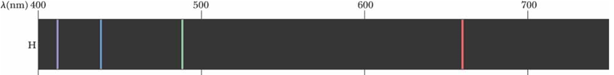
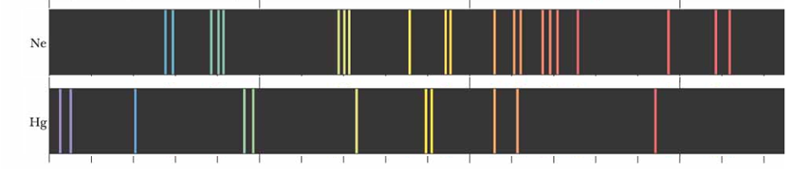
Increasing Complexity
1 e⁻
10 e⁻
80 e⁻
Atomic Transitions
(movement of electrons)
+
Molecular Transitions
(movement of electron density)
250 e⁻

Slide 7
Transitions
hν
hν
Atomic Transitions
hν
hν
Molecular Transitions

Slide 8
Types of Molecular Transitions
σ - σ*
λ_{max} < 150 nm
π - π*
λ_{max} 200 - 800 nm
n - π*
λ_{max} 150 - 300 nm

Slide 9
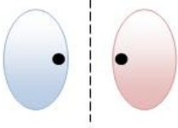

Types of Molecular Transitions
σ - σ*
λ_{max} < 150 nm
High energy photons
methane = 125 nm
ethane = 135 nm
Antibonding
hν
Bonding
Ground State
Excited State

Slide 10
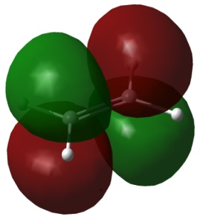
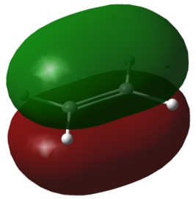
Types of Molecular Transitions
π - π*
λ_{max} 200 - 800 nm
Visible photons
benzene = 260 nm
tetracene = 500 nm
Antibonding
hν
Bonding
Ground State
Excited State

Slide 11
Types of Molecular Transitions
n - π*
λ_{max} 150 - 300 nm
Visible photons
acetone = 280 nm
pyridine = 270 nm
Antibonding
hν
Non-Bonding
Ground State
Excited State

Slide 12
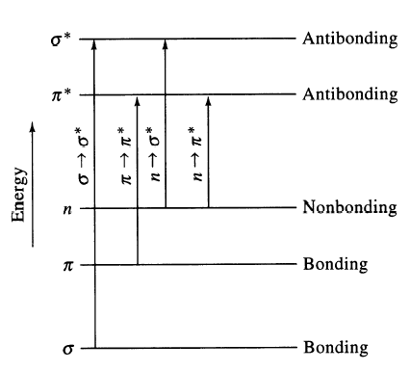
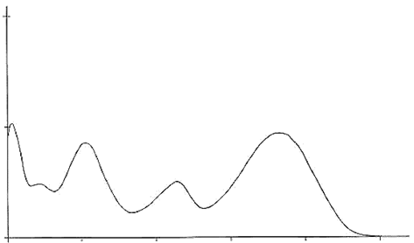
Types of Molecular Transitions
σ - σ*
λ_{max} < 150 nm
π - π*
λ_{max} 200 - 800 nm
σ - σ*
π - π*
Absorption
n - π*
λ_{max} 150 - 300 nm
n - π*
100
200
300
400
500
Wavelength (nm)

Slide 13
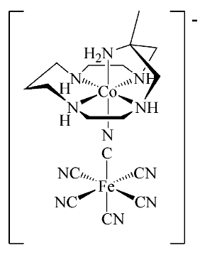
Types of Molecular Transitions
[Co(H₂O)₆]²⁺
Metal Centered (MC)
λ_{max} 200 –800 nm
MnO₄⁻
MLCT
λ_{max} 300 –1000 nm
LMCT
λ_{max} 300 –1000 nm
MMCT
λ_{max} 300 –800 nm

Slide 14
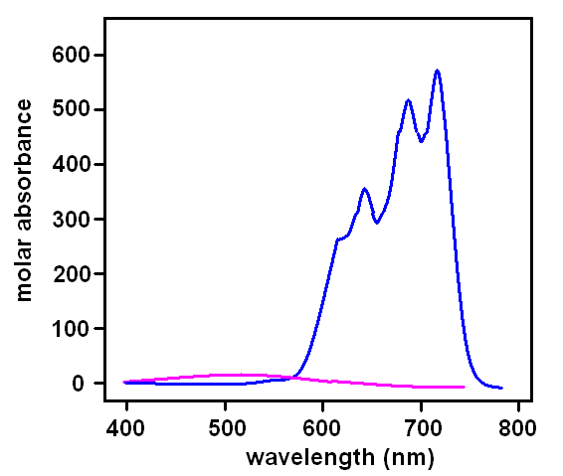
Types of Molecular Transitions
Metal Centered (MC)
d-d transitions
λ_{max} 200 – 800 nm
e_{g}
t_{2g}
[CoCl₄]²⁻
M
M + L
3d and 4d transition metals (+ ligands)
Relatively weak (0-1000 M⁻¹cm⁻¹)
Early structural determination
[Co(H₂O)₆]²⁺

Slide 15
Types of Molecular Transitions
Metal-to-Ligand Charge Transfer (MLCT)
λ_{max} 300 – 1000 nm
e_{g}
e⁻
π*
hν
t_{2g}
π - π*
M
M + L
L
MLCT
Low-lying empty ligand orbital
Low oxidation state metal (electron rich)
High d orbital energy

Slide 16
Types of Molecular Transitions
Ligand-to-Metal Charge Transfer (LMCT)
λ_{max} 300 – 1000 nm
e⁻
e_{g}
Mn-O₄⁻
O²⁻ (π) → Mn⁷⁺
Purple
t_{2g}
π
e⁻
Cd-S
S²⁻ (π) → Cd²⁺
Yellow
M
M + L
L
Ligand with high E lone pairs (S or Se)
Metal with low-lying empty orbitals

Slide 17
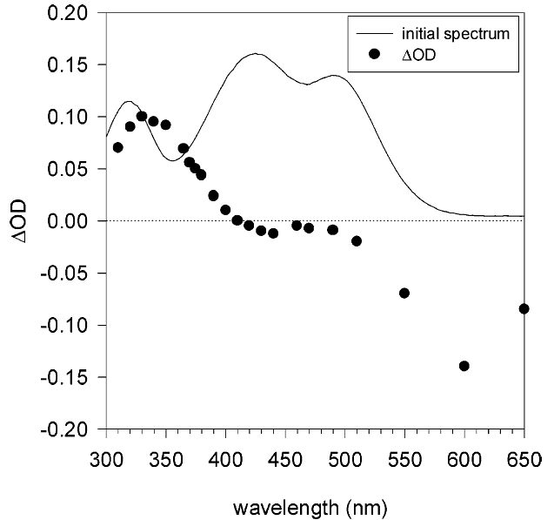
Types of Molecular Transitions
Metal-to-Metal Charge Transfer (MMCT)
λ_{max} 300 – 800 nm
III
e⁻
II
MMCT
e_{g}
e_{g}
t_{2g}
M¹
M²
t_{2g}
M¹ + L
M² + L

Slide 18
Types of Molecular Transitions
π∗
e⁻
e⁻
e_{g}
e⁻
e_{g}
M¹
t_{2g}
M²
t_{2g}
MLCT
π
MC
Absorption
LMCT
M¹ + M² + L
MMCT
300
400
500
600
700
Wavelength (nm)

Slide 19
Complete Diagram
Transitions
σ - σ*
E₂
σ - π*
π - π*
Transitions
n - π*
Electronic
n - σ*
E₁
Vibrational
Energy
Rotational
MC
MLCT
LMCT
MMCT
E₀

Slide 20
Complete Diagram
Jablonski Diagram
S₂
E₂
S₁
Energy
Transitions
Electronic
E₁
Vibrational
S₀
Energy
Rotational
E₀

Slide 21
Complete Diagram
Jablonski Diagram
S₂
S₁
Second Excited State (S₂)
Energy
First Excited State (S₁)
S₀
Excitation
Internal Conversion
Fluorescence
Ground
State (S₀)
Non-radiative decay

Slide 22
Complete Diagram
Jablonski Diagram
S₂
hν
S₁
Energy
Ground State
S₀
Singlet Excited State
S₁
S₀
Excitation
Internal Conversion
Fluorescence
Non-radiative decay

Slide 23
Triplet/Singlet Excited States
Lower Energy
Nicholas J. Turro, Principles of Molecular Photochemistry
Notes:
Triplet Requires e⁻ Spin Flip
Unallowed –
Conservation of Momentum
Allowed by-
Spin-Orbit Coupling

Slide 24
Spin-Orbit Coupling
Notes:
ms = spin of the electron
ml = direction of the orbital
l = shape of the orbital
n = size/energy of the orbital

Slide 25
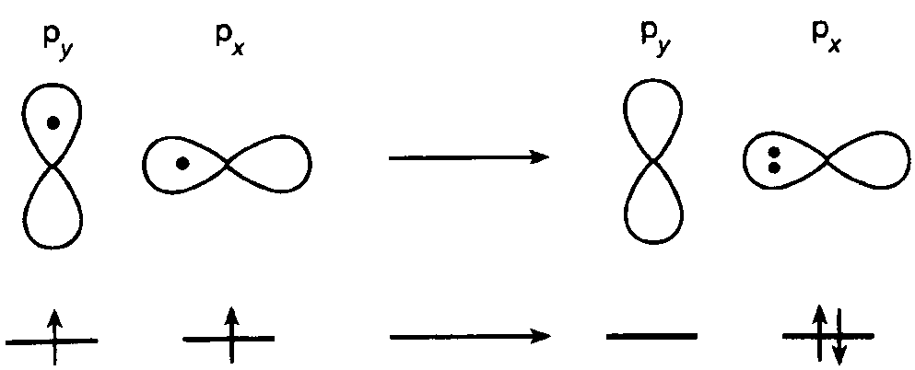
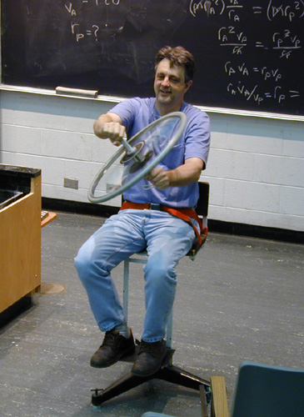
Spin-Orbit Coupling
Quantum Numbers
n = Principal
l = Angular
m_{l} = Magnetic
m_{s} = Electron spin
Heavy Atoms
Pt, Ir, I...
Rotating Chair and Bicycle Wheel
Nicholas J. Turro, Principles of Molecular Photochemistry
Notes:
ms = spin of the electron
ml = direction of the orbital
l = shape of the orbital
n = size/energy of the orbital

Slide 26
Jablonski Diagram
S₂
Excitation
Internal Conversion
Fluorescence
Non-radiative decay
Intersystem Crossing
Phosphorescence
S₁
T₂
Energy
T₁
S₀

Slide 27
Jablonski Diagram of Anthracene
Nicholas J. Turro, Principles of Molecular Photochemistry

Slide 28
Other Processes
S₂
S₁
T₂
Energy
T₁
Electron transfer
TICT
ESIPT
Photochemical
Reactions
S₀
Excitation
Internal Conversion
Fluorescence
Non-radiative decay
Intersystem Crossing
Phosphorescence

Slide 29
Excited State Electron Transfer
e⁻
hν
e⁻
+
A
Ru^{III}(bpy)₃ + A⁻
e⁻
hν
+
+
Ru^{II}(bpy)₃
[Ru^{II}(bpy)₃]*
A
Ru^{III}(bpy)₃
A⁻

Slide 30
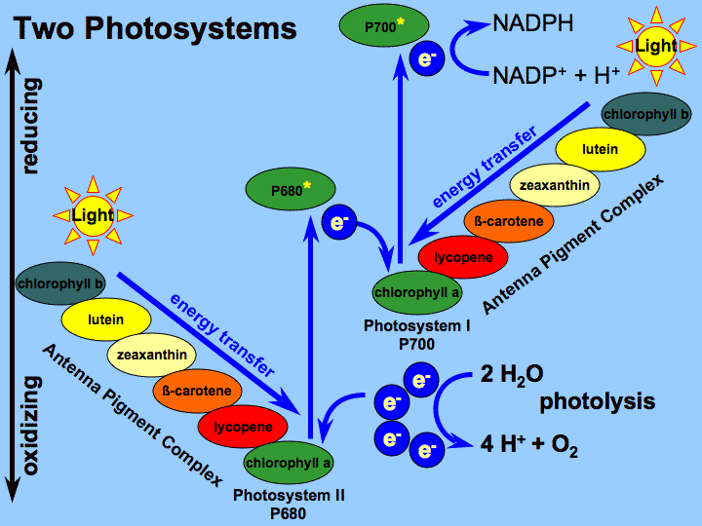
Excited State Electron Transfer
Photosynthesis

Slide 31
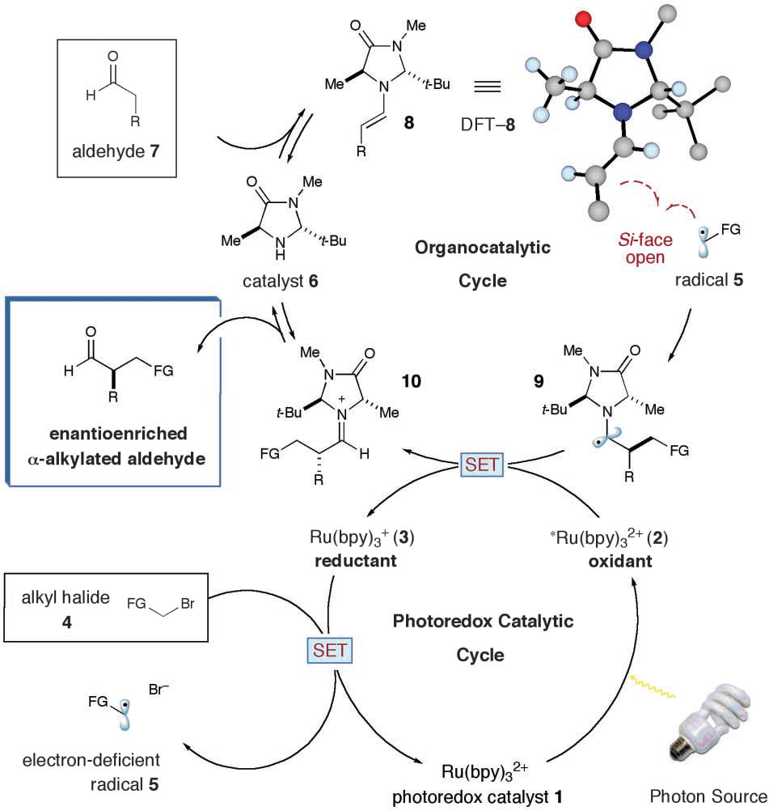
Excited State Electron Transfer
Photocatalytic α-alkylation of aldehydes
Nicewicz, D. A.; MacMillan, D. W. C. Science 2008, 322, 77-80.

Slide 32
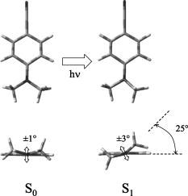
Excited State Structural Change
Twisted Intramolecular Charge Transfer
e⁻
e⁻
Pratt et al. J. Chem. Phys. 2005, 122, 084309

Slide 33


Excited State Structural Change
Excited State Proton Transfer
ESIPT
absorption
reverse proton transfer
emission
Hanson et al. Org. Lett. 2011, 13, 1598

Slide 34
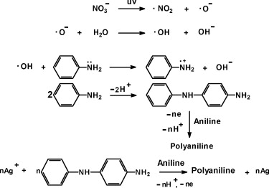
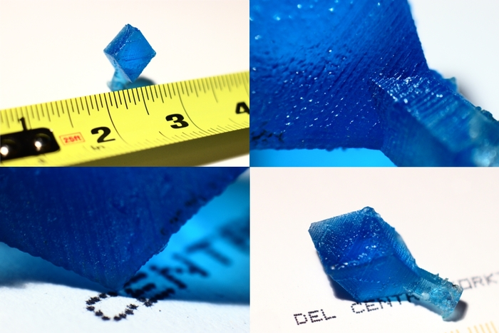
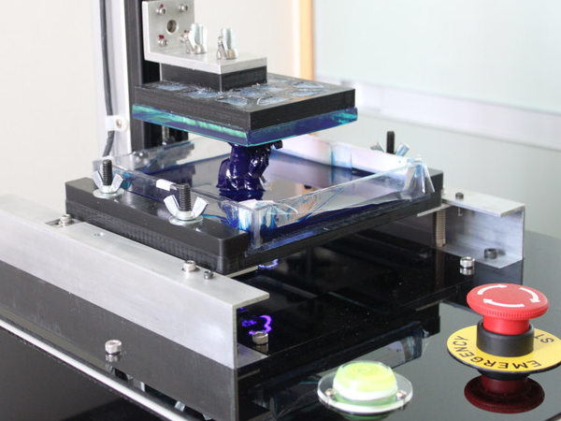
Photochemical Reactions
Photopolymerization
Peachy Printer ($100)
Notes:
vision

Slide 35
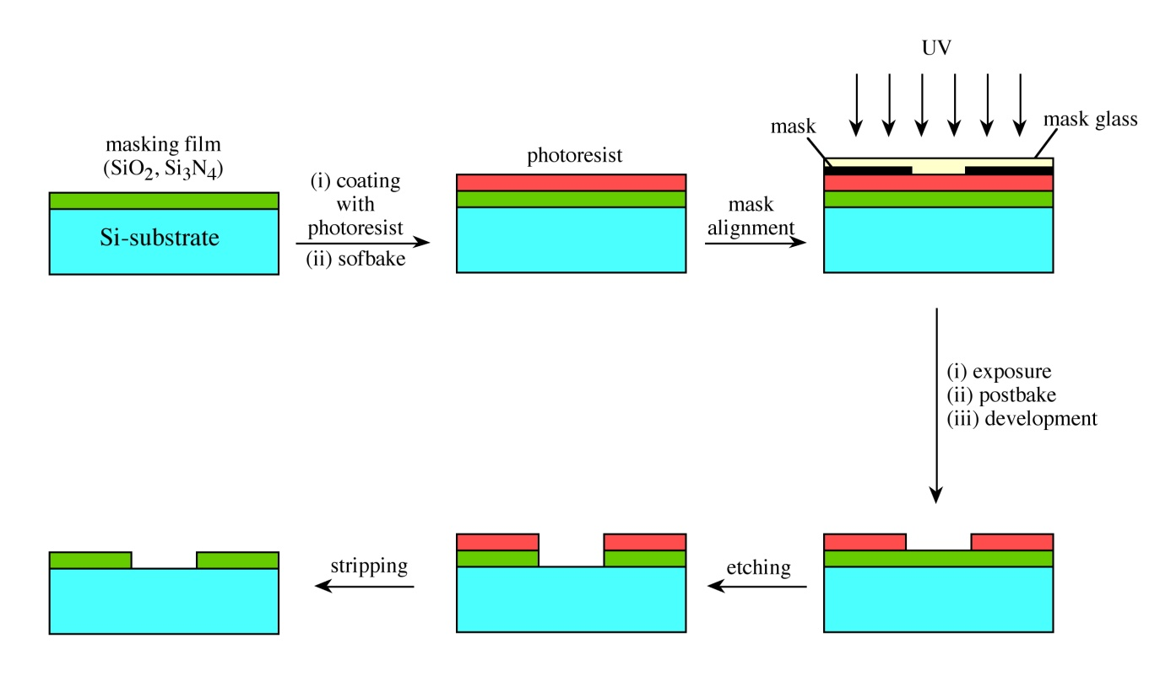
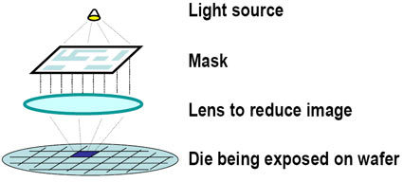
Photochemical Reactions
Photolithography

Slide 36
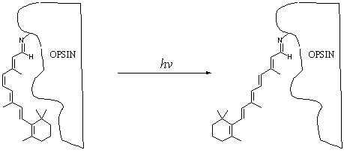
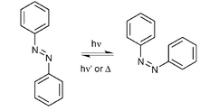
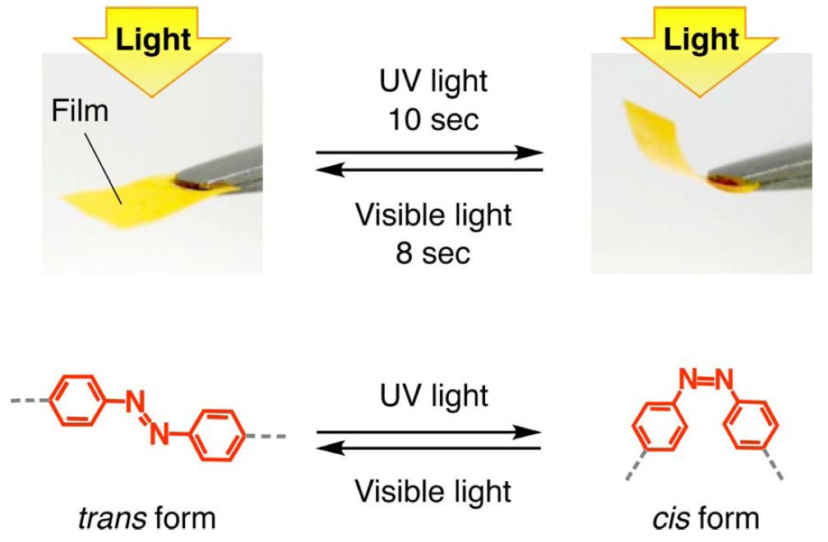
Photochemical Reactions
Photoisomerization
hν
Ground State
Excited State

Slide 37
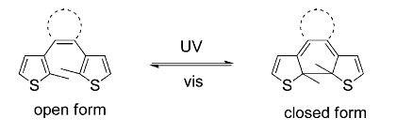
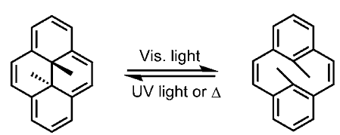
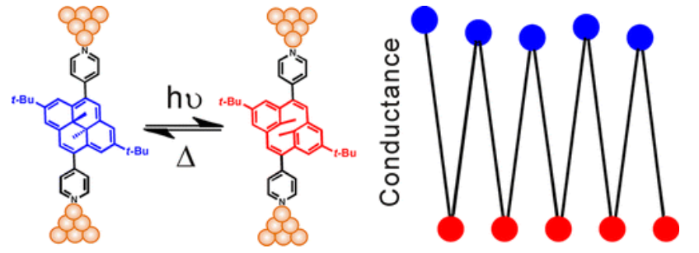
Photochemical Reactions
Photoswitches
J. Am. Chem. Soc., 2013, 135 (16), pp 5974–5977

Slide 38
“Complete” Jablonski Diagram
S₂
Product
S₁
T₂
E
T₁
Product
S₀
Processes
Excitation
Fluorescence
Phosphorescence
Non-radiative decay
Internal conversion
Intersystem crossing
Photochemistry
Measurement Technique
Absorption Spectroscopy
Fluorescence Spectroscopy
Transient Absorption Spectroscopy
Solar Cell Testing

Slide 39
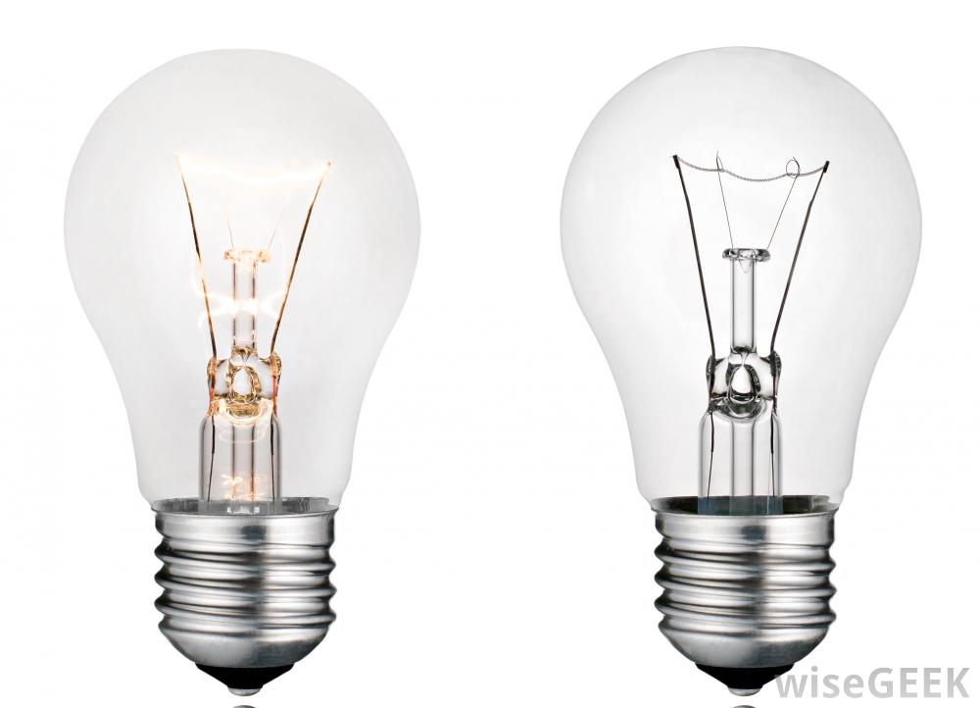
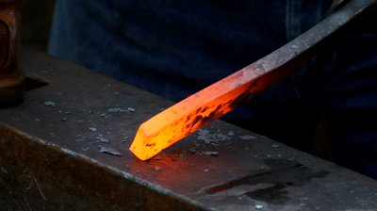
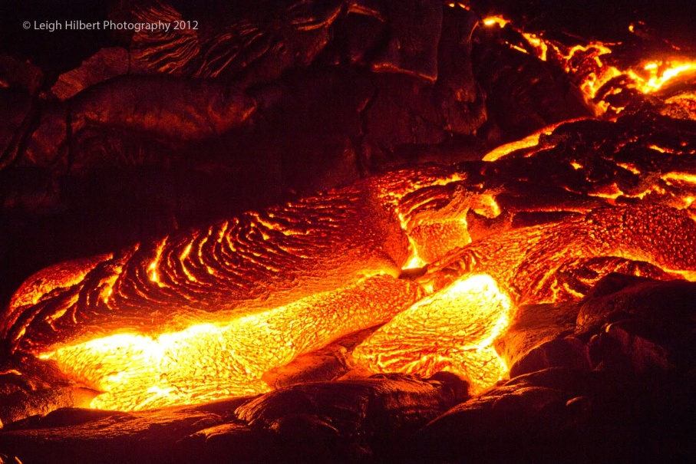
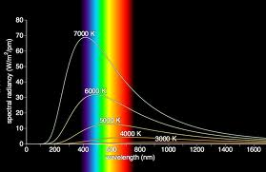
Side Note: Other Excitations
Thermal Excitation

Slide 40
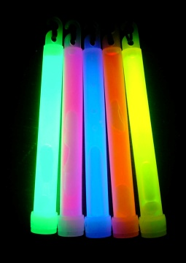
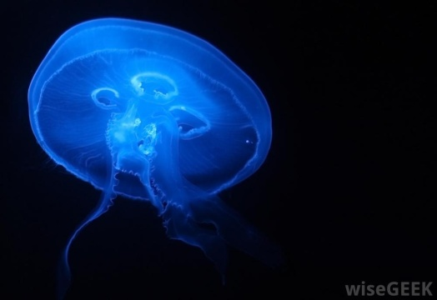
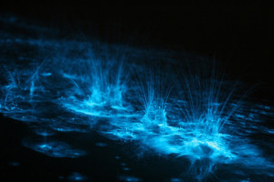
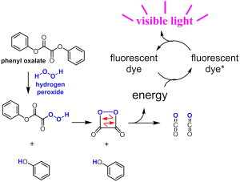
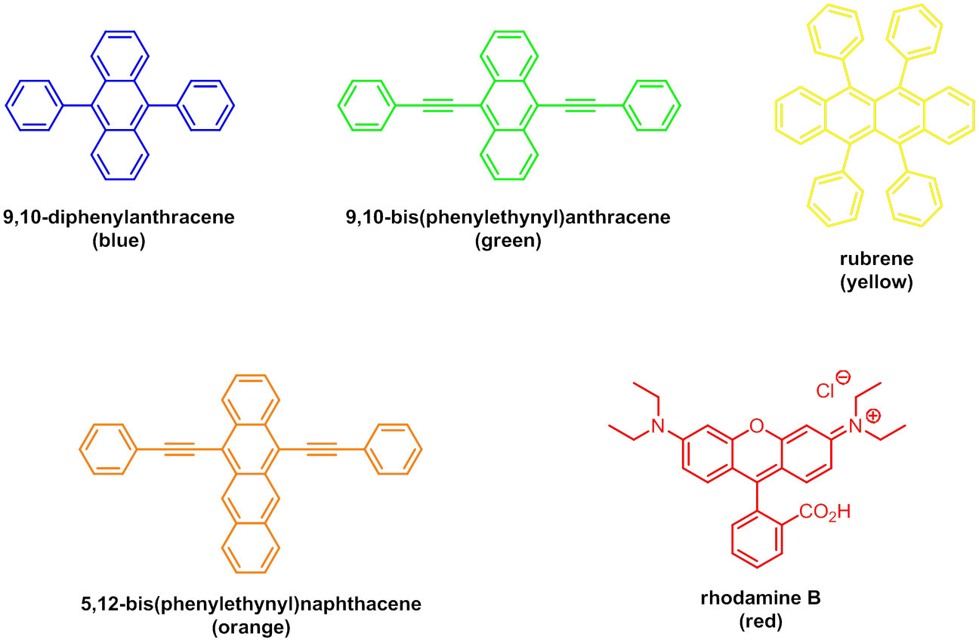
Side Note: Other Excitations
Chemical Excitation

Slide 41
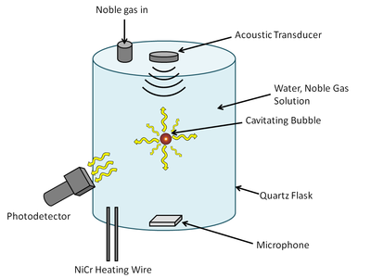
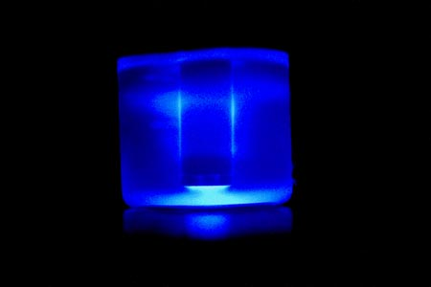
Side Note: Other Excitations
Sonoluminescence

Slide 42
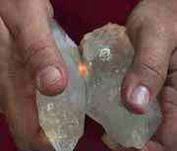
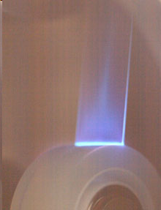
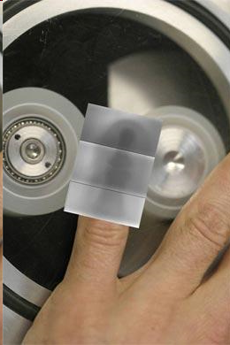
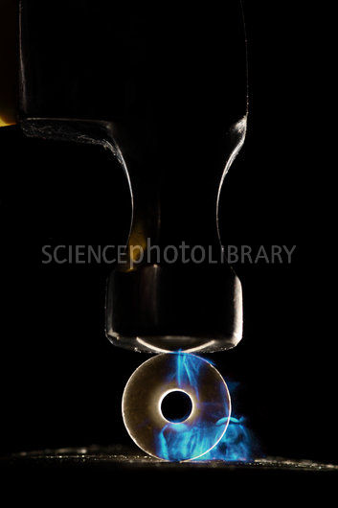
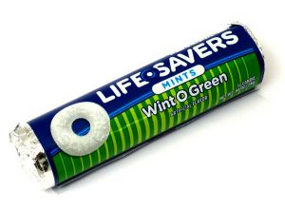
Side Note: Other Excitations
Tribo/Fractoluminescence
Nature 2008, 455, 1089–1092.

Slide 43



Side Note: Other Excitations
Electroluminescence

Slide 44


Side Note: Dye Structure

Slide 45





Side Note: Dye Structure
Bright Blue Common Food Uses Beverages, dairy products, powders, jellies, confections, condiments, icing. | Royal Blue Common Food Uses Baked goods, cereals, snack foods, ice-cream, confections, cherries.
Orange-red Common Food Uses Gelatins, puddings, dairy products, confections, beverages, condiments. | Lemon-yellow Common Food Uses Custards, beverages, ice-cream, confections, preserves, cereals.
Orange Common Food Uses Cereals, baked goods, snack foods, ice-cream, beverages, dessert powders, confections

Slide 46
Molecular Photophysics End
Any Questions?

